Slide 1



CSCI 1070 Final Project
By Marilena Triantafylli

Slide 2
Overview
01
Introduction
03
Hypothesis
05
Charts and Tables
02
Background
04
Methodology
06
Conclusion

Slide 3
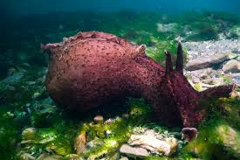
Introduction
For this project I used a dataset obtained from an experiment done with a California Sea Hare as the subject. It was presented and fed with 4 different types of foods. (a. Natural, live, fresh seaweed, b. regular strips of nori, c. tape nori, and d. two-ply nori) while its neural activity, more specifically the buccal nerve 2 (BN2) activity, was recorded.

Slide 4
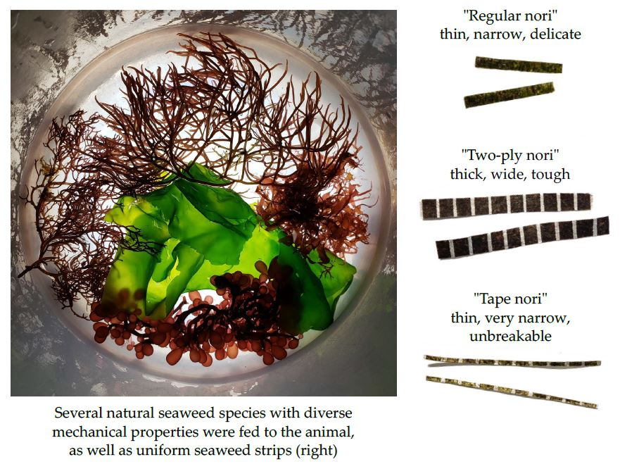
Background Information
Food
Fresh Food: live seawood in the form it is found in nature by the animal.
Regular nori: light and easy to swallow by the animal
Tape nori: unbreakable two stripped plastic tape between nori
Two-ply nori: widely cut stripes of nori bound together. Hard to swallow as well.

Slide 5
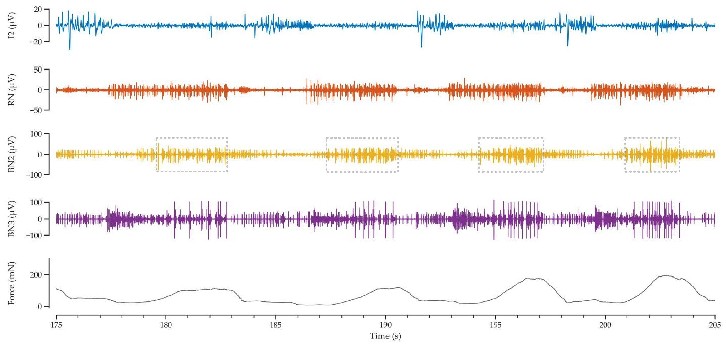
Background Information
Nerve
Buccal Nerve 2 plays a significant role in both sensory and motor skills of an animal related to its feeding behaviors.
It was important to use that specific nerve because by measuring its activity and the duration of it we can make conclusions on the animal’s digestive preferences.The recordings were obtain by the use of an electrode and were in the following form.

Slide 6
Hypothesis
Original Hypothesis
There is a positive correlation among all food types and the buccal nerve response, and the biggest one is with the Fresh Food, since that is what they find in nature.
Null Hypothesis
There is no correlation between the food types and the BN2 responses.
Alternative Hypothesis
There is a negative correlation among all food types and the buccal nerve response, and the biggest one is with the Fresh Food.

Slide 7
Methodology
Variables: Food, BN2 burst duration (s), BN2 burst mean rectified voltage (μV), Force Peak (mN)
One-hot encoding: Food variable, and set Tape nori as my baseline.
Dropped: 1. Force Peak, 80% of the values were NA.
2. Food, it was a categorical variable.
3. Tape nori, it was my baseline but it was represented by the intercept.
Multiple Linear Regression:
Independent Variables: BN2 burst duration (s) + Food_Fresh_Food + Food_Regular_nori + Food_Two_ply_nori
Dependent Variable: BN2 burst mean rectified voltage (μV)

Slide 8
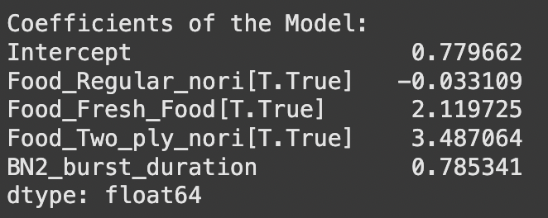

Methodology
I calculated the Coefficient and Intercept which represented the Tape nori:
I made sure to calculate and plot the residuals.
Finally, I found the R-squared equal to approximately 0.61, which is typically considered strong for biological measurements.

Slide 9
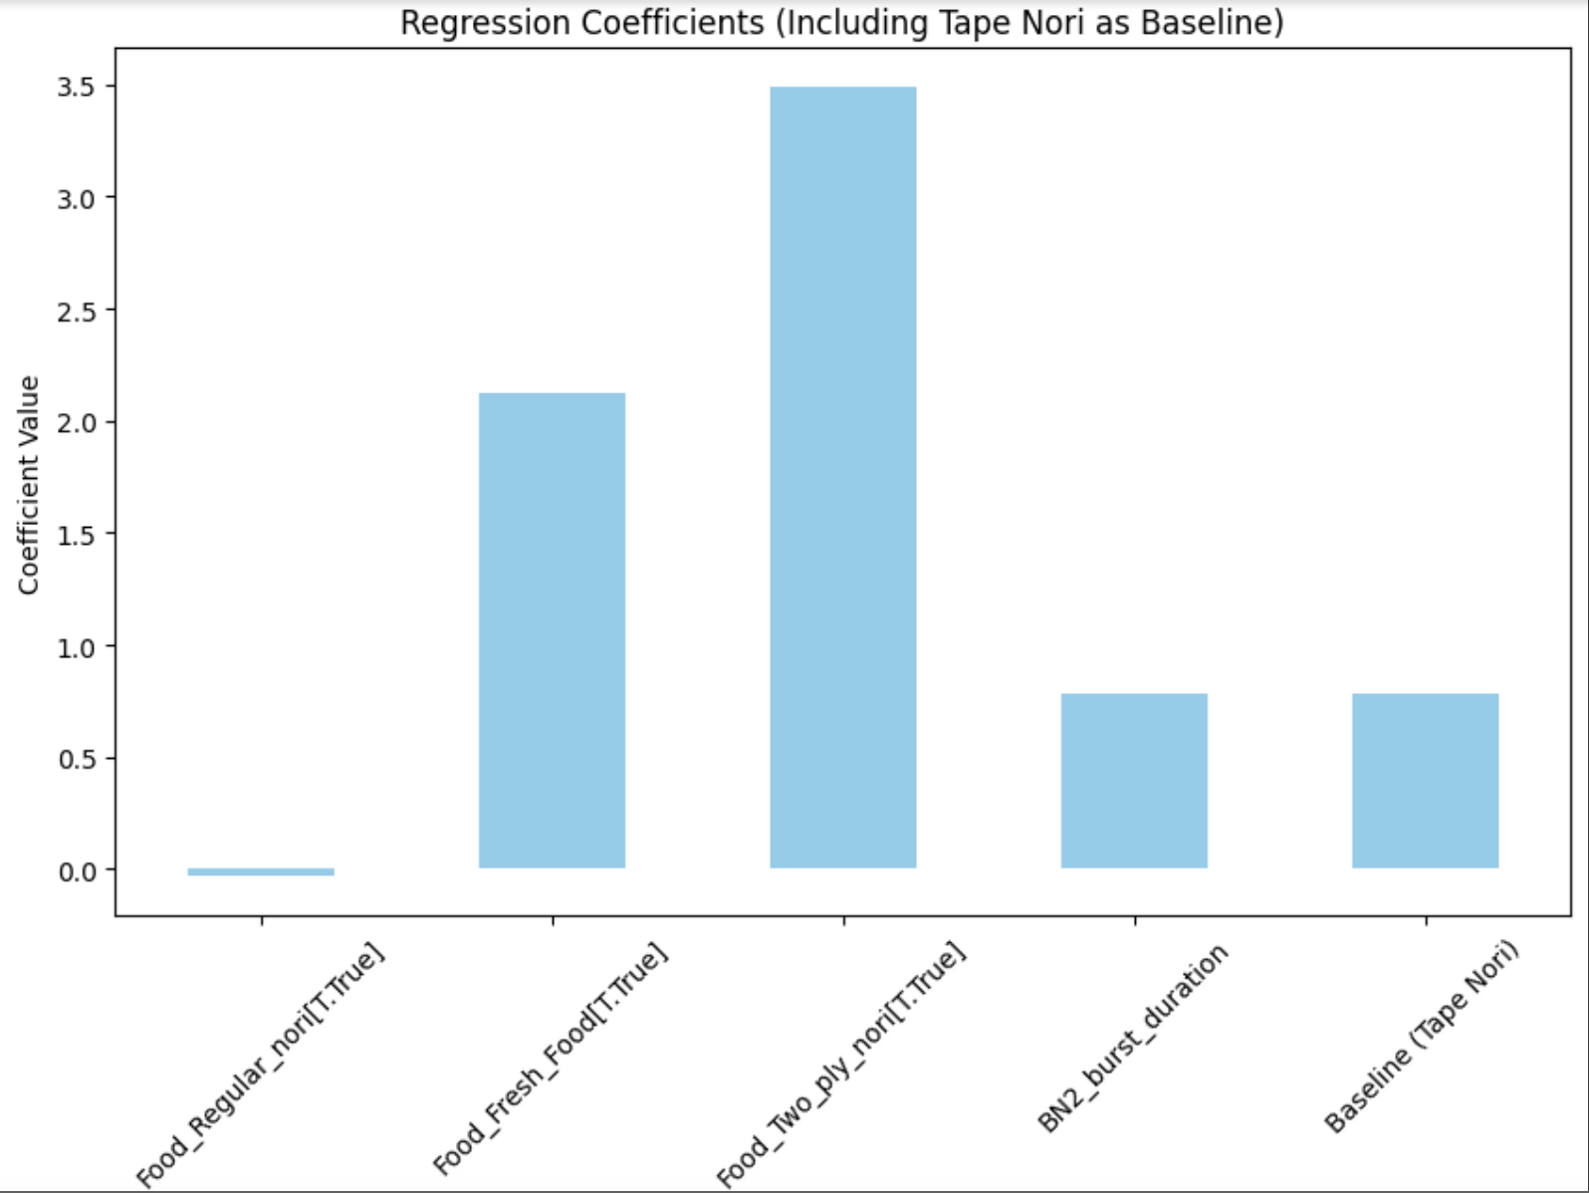
Charts and Tables
This shows that they all have positive regression coefficients, therefore a positive correlation with BN2 burst mean voltage.
verifying original hypothesis
The highest coefficient is that of Two ply nori and not the Fresh Food
rejecting original hypothesis

Slide 10
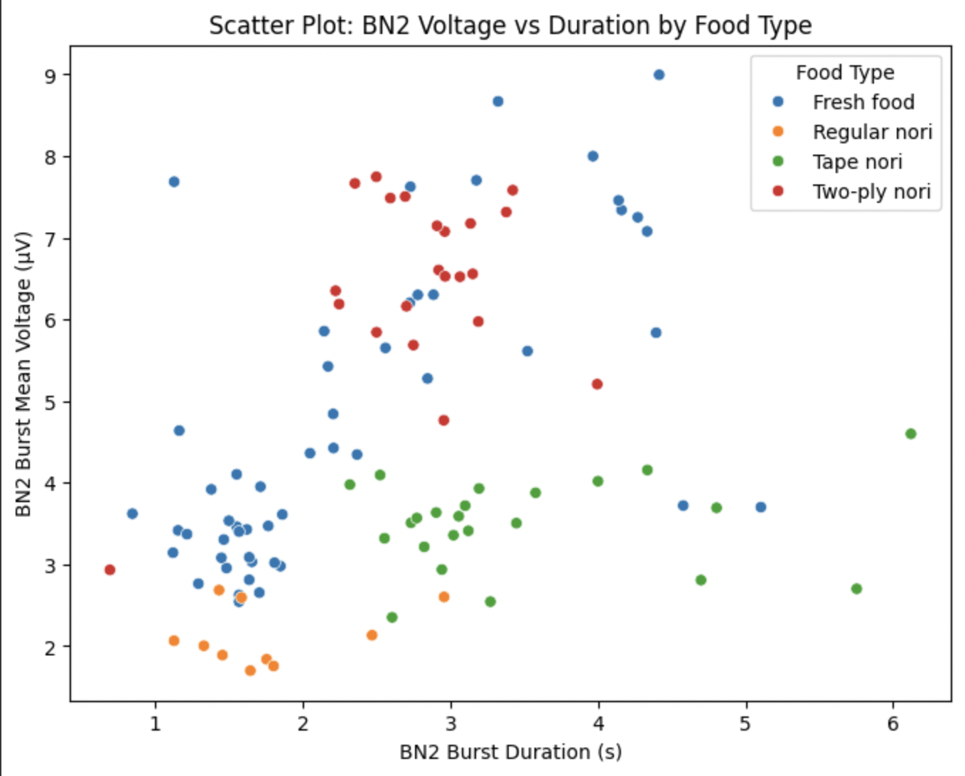
Charts and Tables
This reveals a general positive correlation among BN2 Duration and the BN2 mean voltage, which was expected by the previous coefficient table.
Fresh Food: spread across the whole plot and has a 3-9 range
responses vary, the highest the voltage, usually the higher the duration.
Regular nori: centered in the left down area of the plot.
indicated that buccal nerve response is weak and short

Slide 11
Charts and Tables
Tape nori: centered in the lower part of the plot (<4)
weaker BN2 voltage than fresh food and two ply nori but has the highest duration.
Two-ply nori: centered in the upper middle part of the plot
high voltage response but moderate duration.

Slide 12
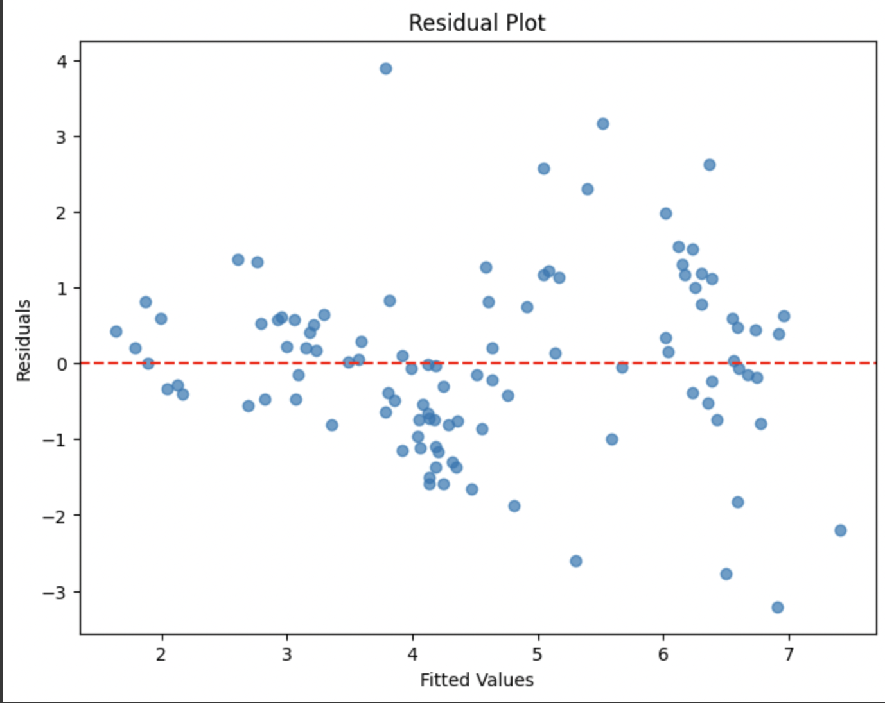
Charts and Tables
I plotted the residuals and I figured out that there is no significant systematic overprediction or underprediction of the data.

Slide 13
Conclusion
After observation and calculation around the dataset we figured out that our original hypothesis was partially flawed. We successfully predicted a positive correlation amongst all food type and the nerve’s response, but the highest one was not the Fresh Food one.
It turns out it was the Two-ply nori food type. This could be explain if the response of the BN2 is dependent on the complexity of the texture or ability to be swallowed of the food, instead of a response granted during the evolution of the species.
Finally we reject the null hypothesis since we have sufficient evidence to reach conclusions about this study.

